Slide 1


Underwater surface temperature
COURSE: TIME SERIES ANALYSIS AND MODELING
Presented by:
Pon swarnalaya Ravichandran

Slide 2

Contents
Introduction to Dataset
Stationarity
Time Series Decomposition
Holts-Winter Method
Feature Selection
Base Models
Multiple Linear Regression
ARMA models
SARIMA model
Model comparison
Best model forecast
Conclusion and Future Scope

Slide 3

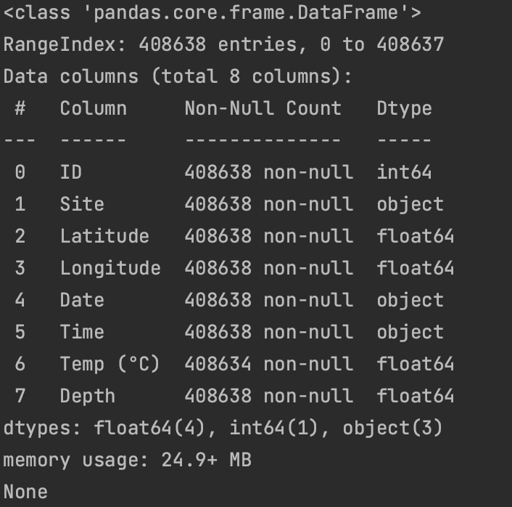
Dataset : Underwater surface temperature Source: Underwater surface temperature dataset from kaggle Shape: 408638 rows x 8 columns
INTRODUCTION TO DATASET:
The dependent variable is “Temp (*C)”
The data is not stationary, unbalanced and continuous.
The null values were removed after preprocessing the dataset

Slide 4
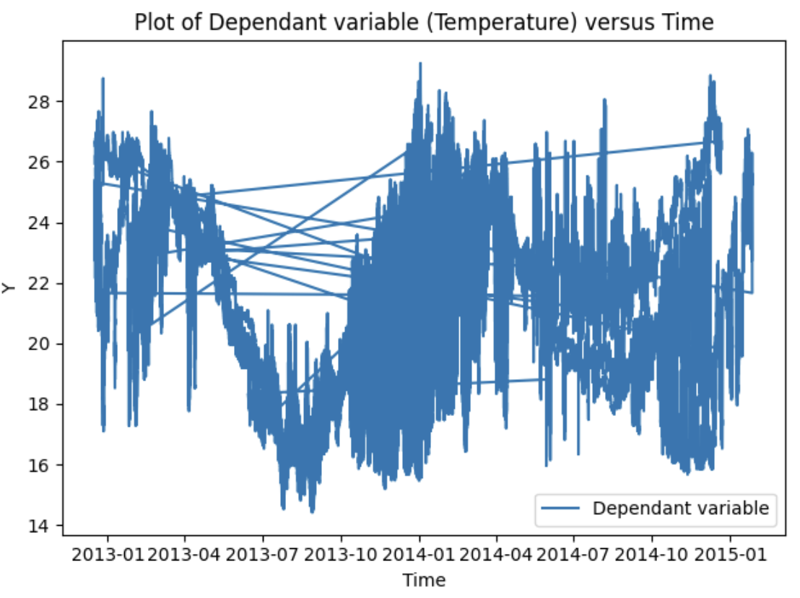
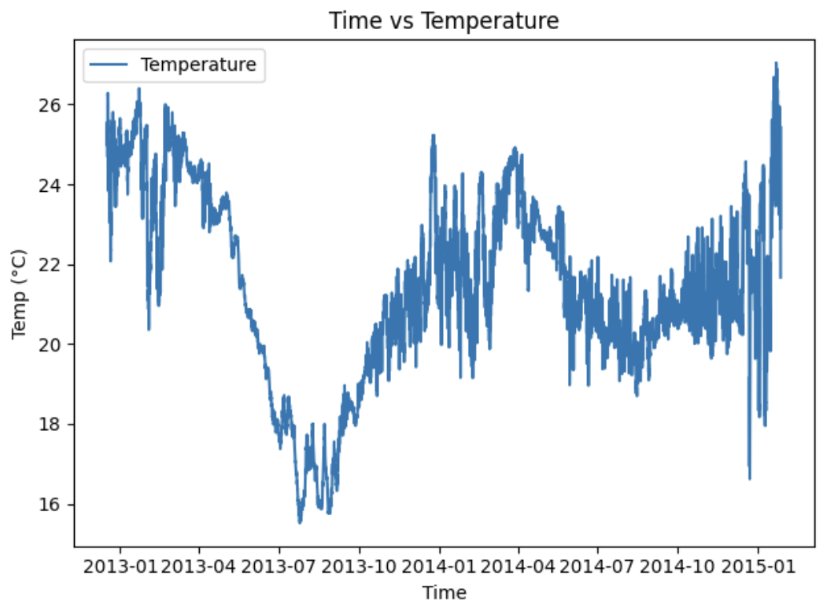
Dataset preprocessing:
The dataset had many observations on the single time.
The data after 1 hour down sampling looks like this. It shows the data is seasonal and trended.

Slide 5
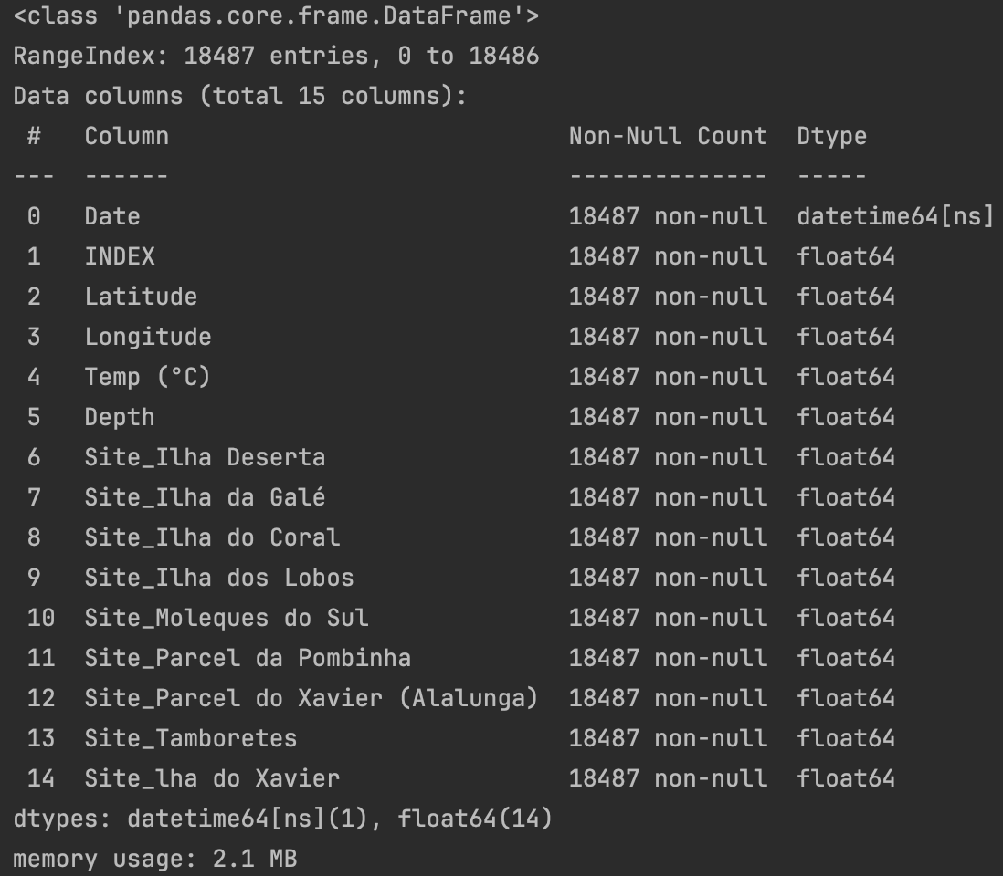
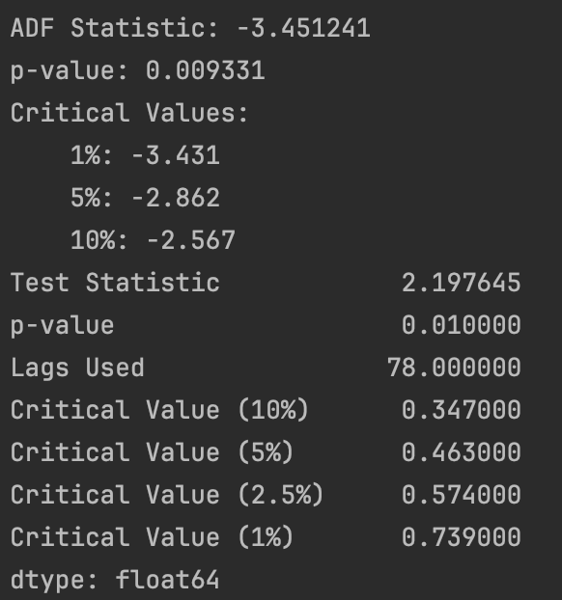
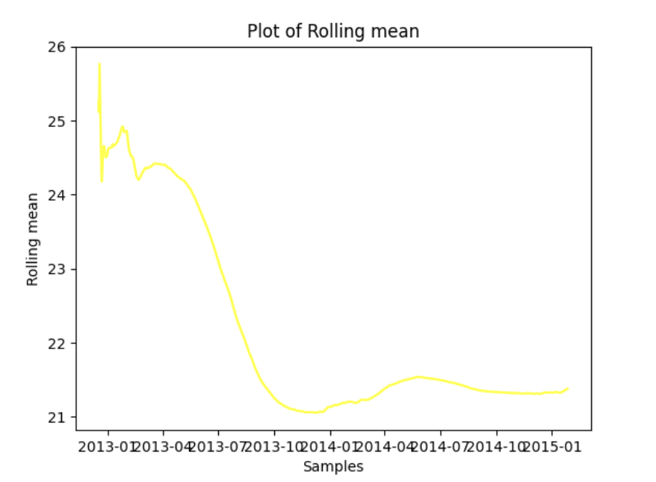
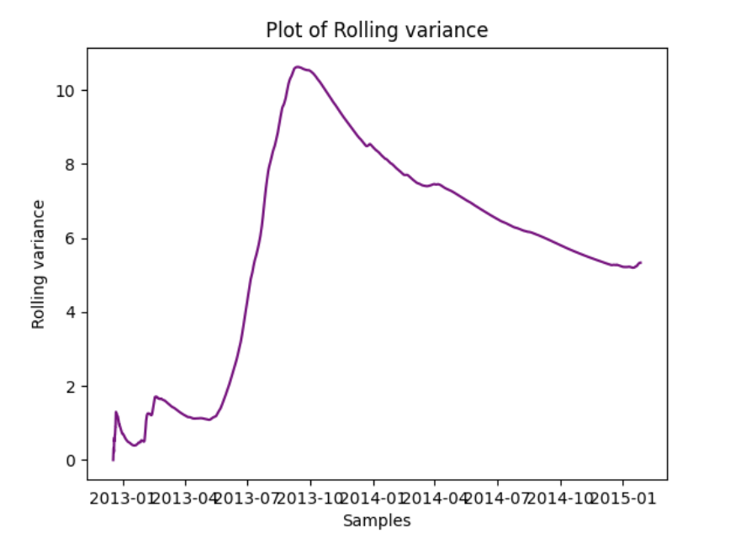
The downsampled dataset had 18487 samples with a shifting in the seasonality cycle to 1260.
The ADF and KPSS test statistics shows that the data is not stationary
The plot of rolling mean and rolling variance shows that the data is not stable and don’t have a flat point.

Slide 6
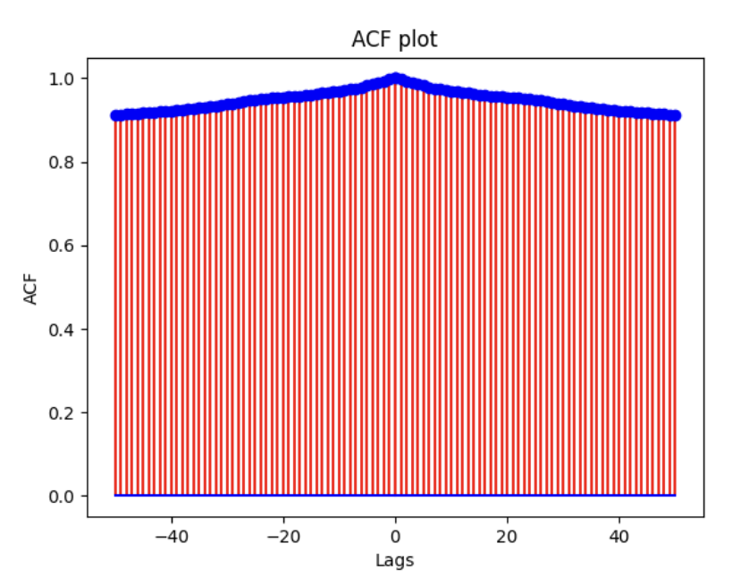
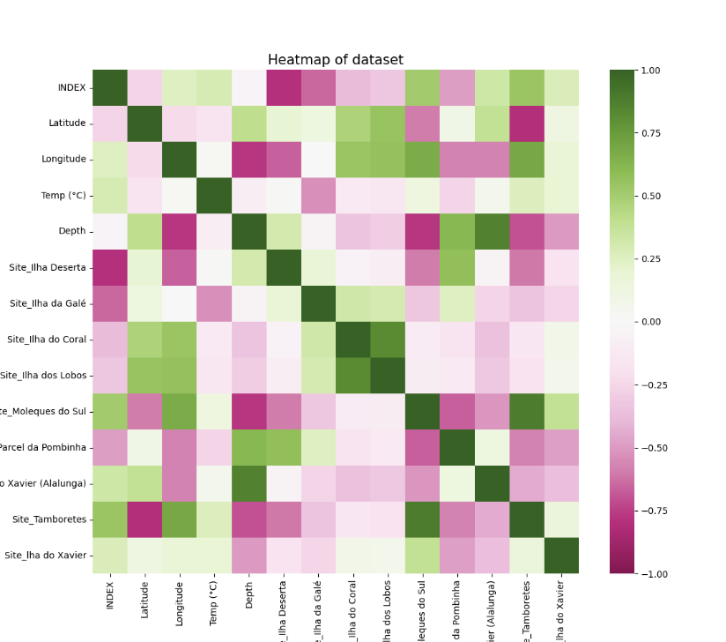
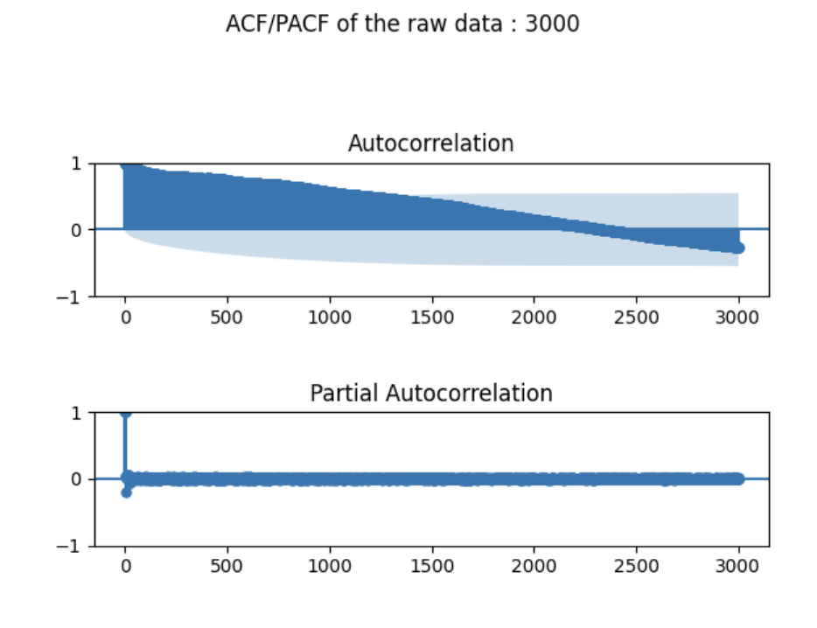
The ACF of plot of raw dataset shows that the data is not white noise.
The ACF/PACF plot shows that the data is seasonal and converges over the time
The given heatmap shows that relatability of the various variable over one other and the correlation between the variables are shown as well.

Slide 7
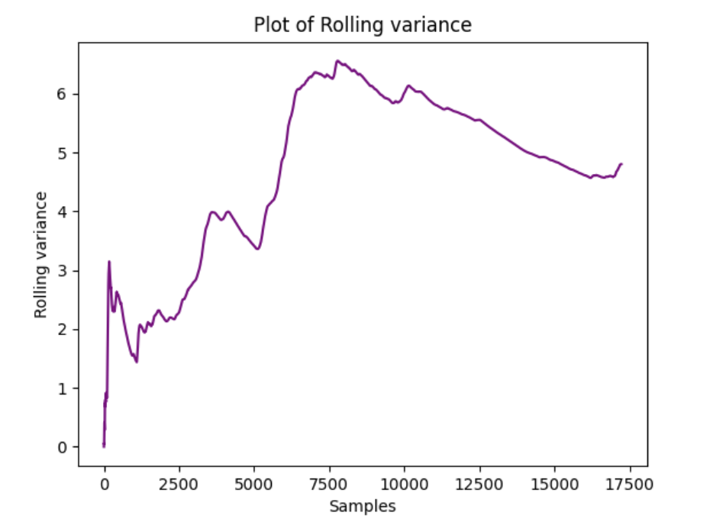

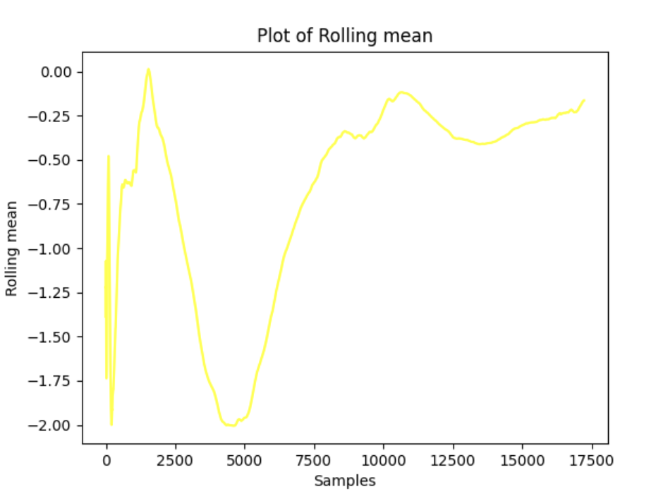
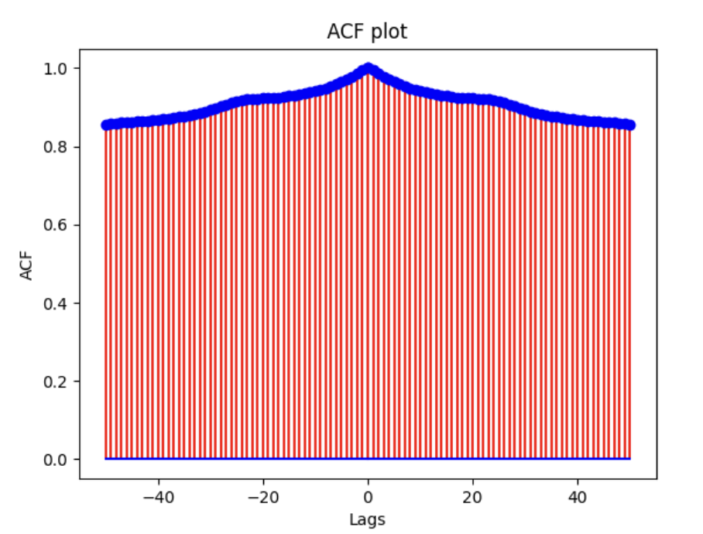

FIRST ORDER DIFFERENCING
The data is not stationary yet
The adf and kpss test shows that the data is not stationary yet.
ACF plot has no white noise and ACF/PACF plot shows a seasonality at 1260
The rolling mean and variance doesn’t have a flat point.

Slide 8
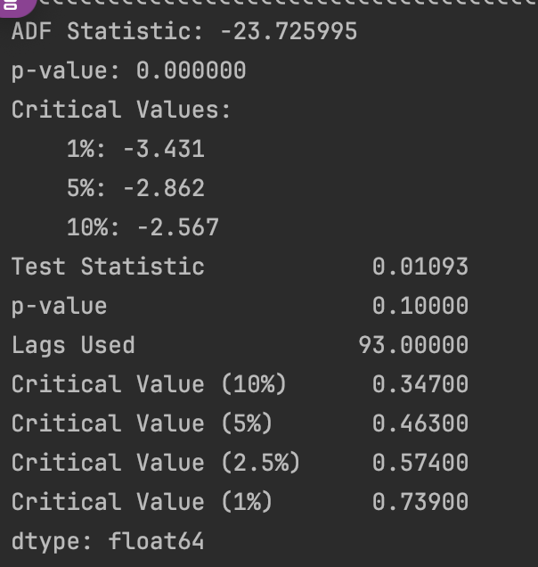
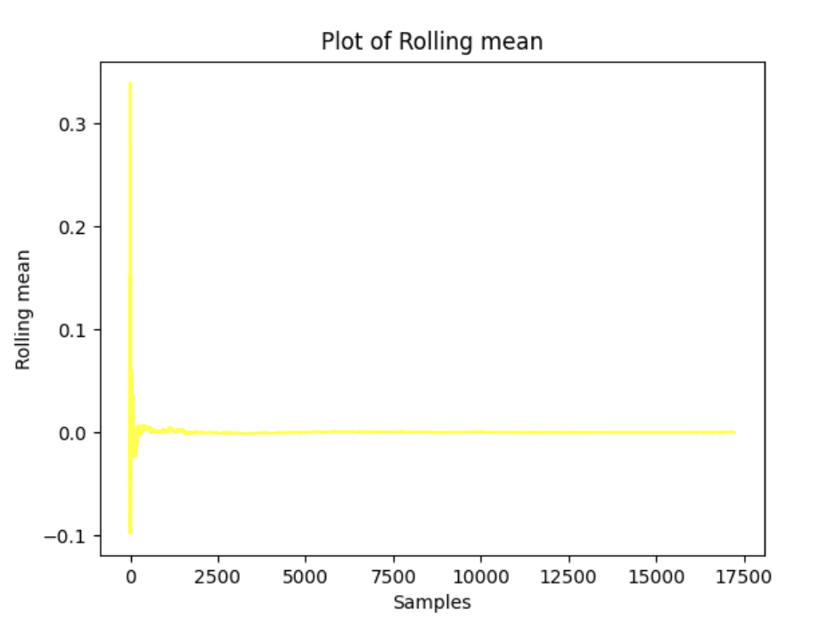
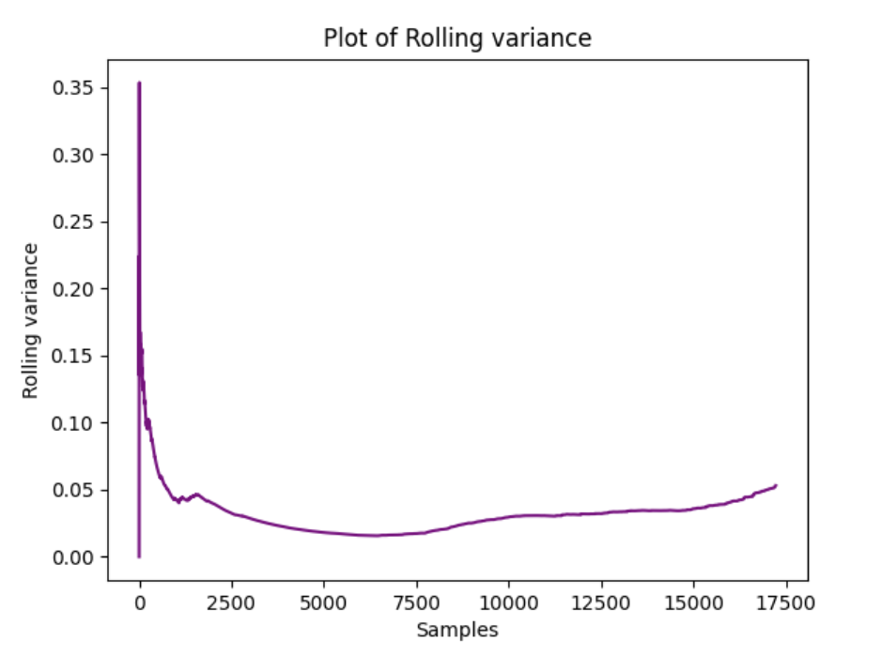
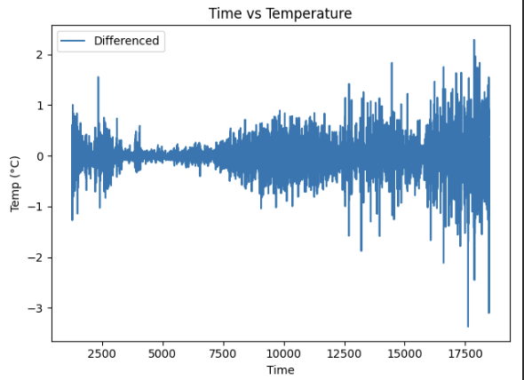
SECOND ORDER DIFFERENCING
The ADF and KPSS test values shows that the data is stationary now
The rolling meen and variance of the second order differenced
Data is more stable with mean in 0 and variance in 0 with a flat point.
The time series plot of temperature vs time of second order differenced data is more meaningful.

Slide 9
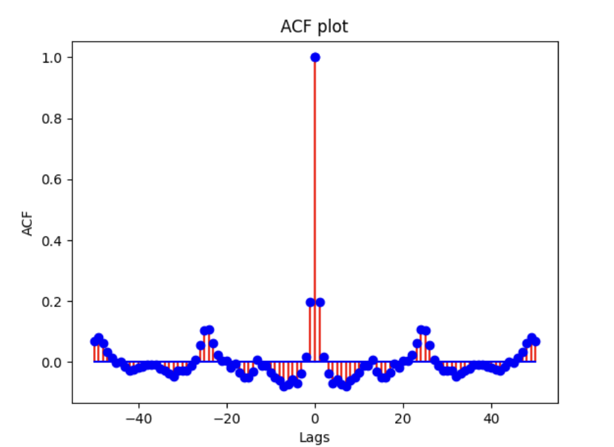
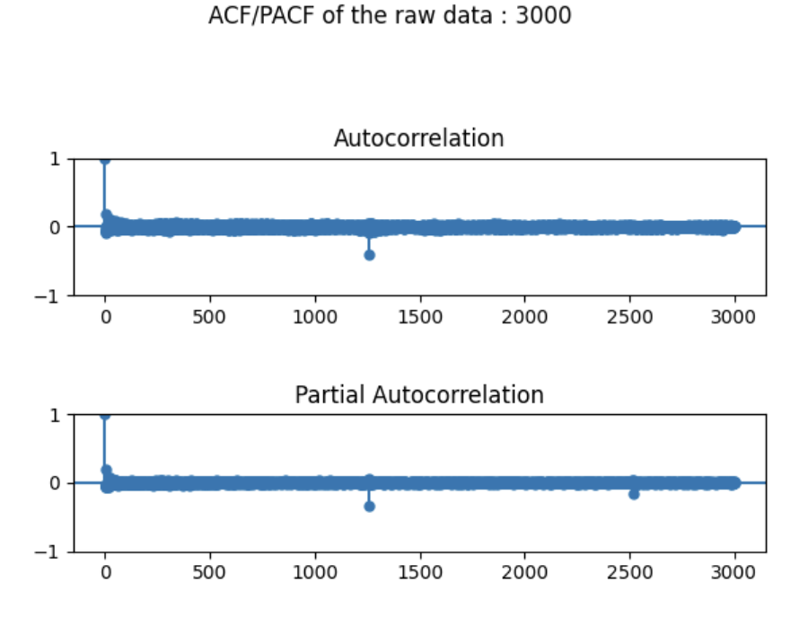
The differenced data looks more leveled than the original data. The symmetric ACF plot shows clear seasonality where the plot converges over the positive values of ACF for a while and moves into the negative values of ACF.
The analysis of the ACF/PACF plots provides compelling evidence that the data exhibits stationarity with a distinct seasonality pattern at a lag of 1260. The ACF plot demonstrates a clear cutoff at lags 0 and 1260, emphasizing that autocorrelation diminishes beyond these points, affirming the stationary nature of the data. The PACF plot shows the evidence of seasonality at every 1260 th lag.

Slide 10
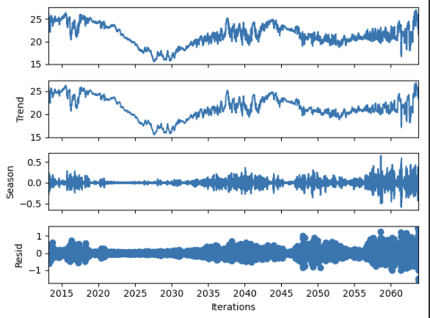
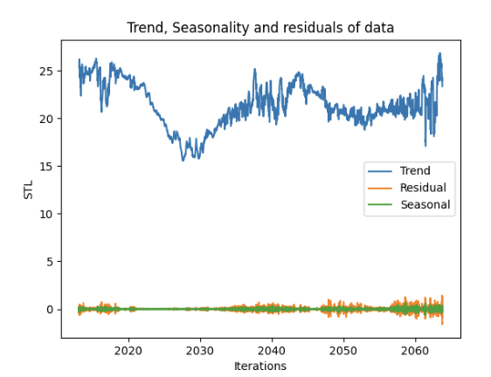
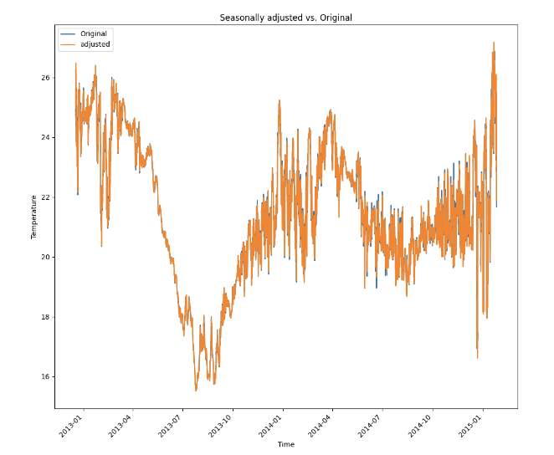
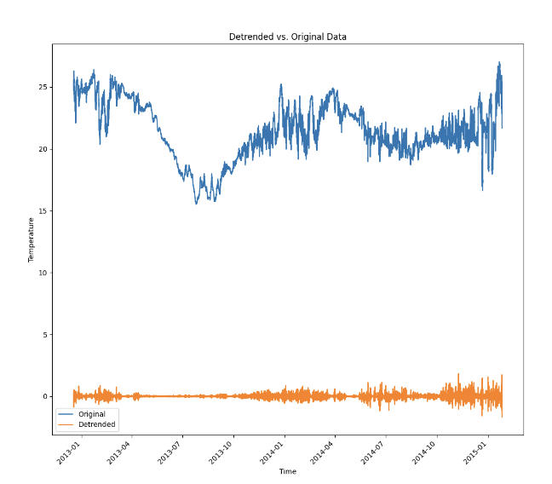
TIME SERIES DECOMPOSITION
The STL plot shows the trend, seasonality and residual of the data.
The seasonally adjusted data shows that the data is completely seasonal and fitted with the original data
The detrended data is away from the original data

Slide 11
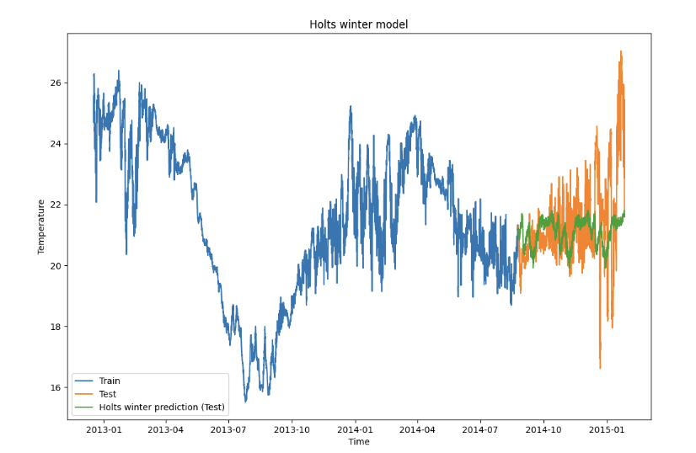
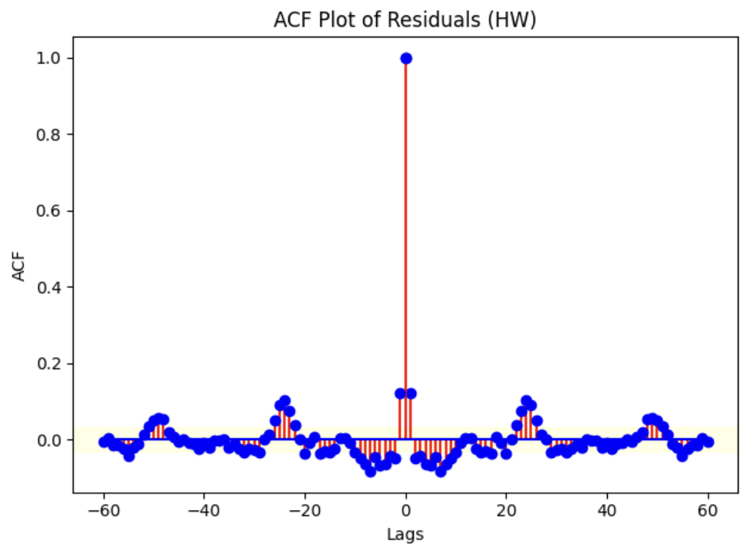
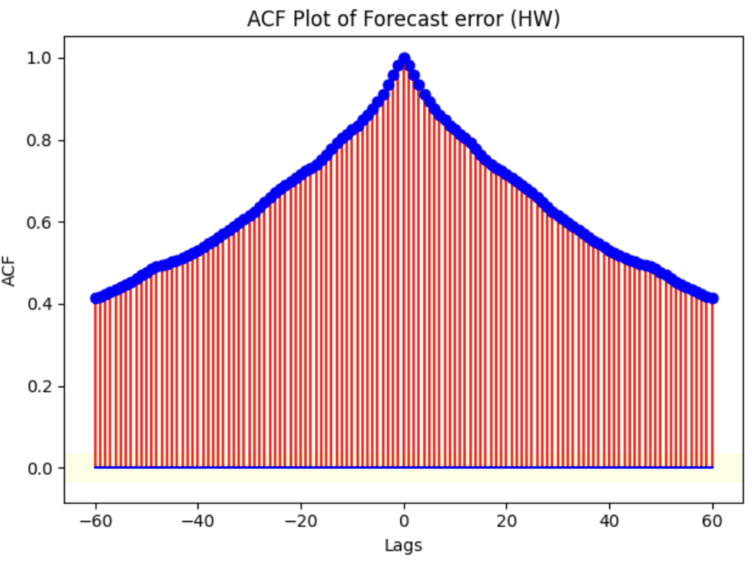
HOLTS-WINTER METHOD
The Holts winter model shows that the train , test and predicted is fitted good with the data. It shows a clear trend over the test set.
The ACF plot of residuals shows that the data is white and converges over time both in the positive and negative lags in a mirrorly manner.
The ACF plot of the forecasted shows that the data is not white and doesn’t converge over time. Even after 60 lags.

Slide 12
PERFORMANCE METRICS OF
HOLT WINTER MODEL/METHOD
METRICS | VALUES
MSE TRAIN | 0.01693
RMSE TRAIN | 0.1268
Q-VALUE | 3573.40
MEAN OF RESIDUAL | -0.00018
MEAN OF FORECASTED | 0.29847
VARIANCE OF RESIDUAL | 0.0160
VARIANCE OF FORECASTED | 2.2641
MSE TEST | 2.35319
RMSE TEST | 1.5340

Slide 13
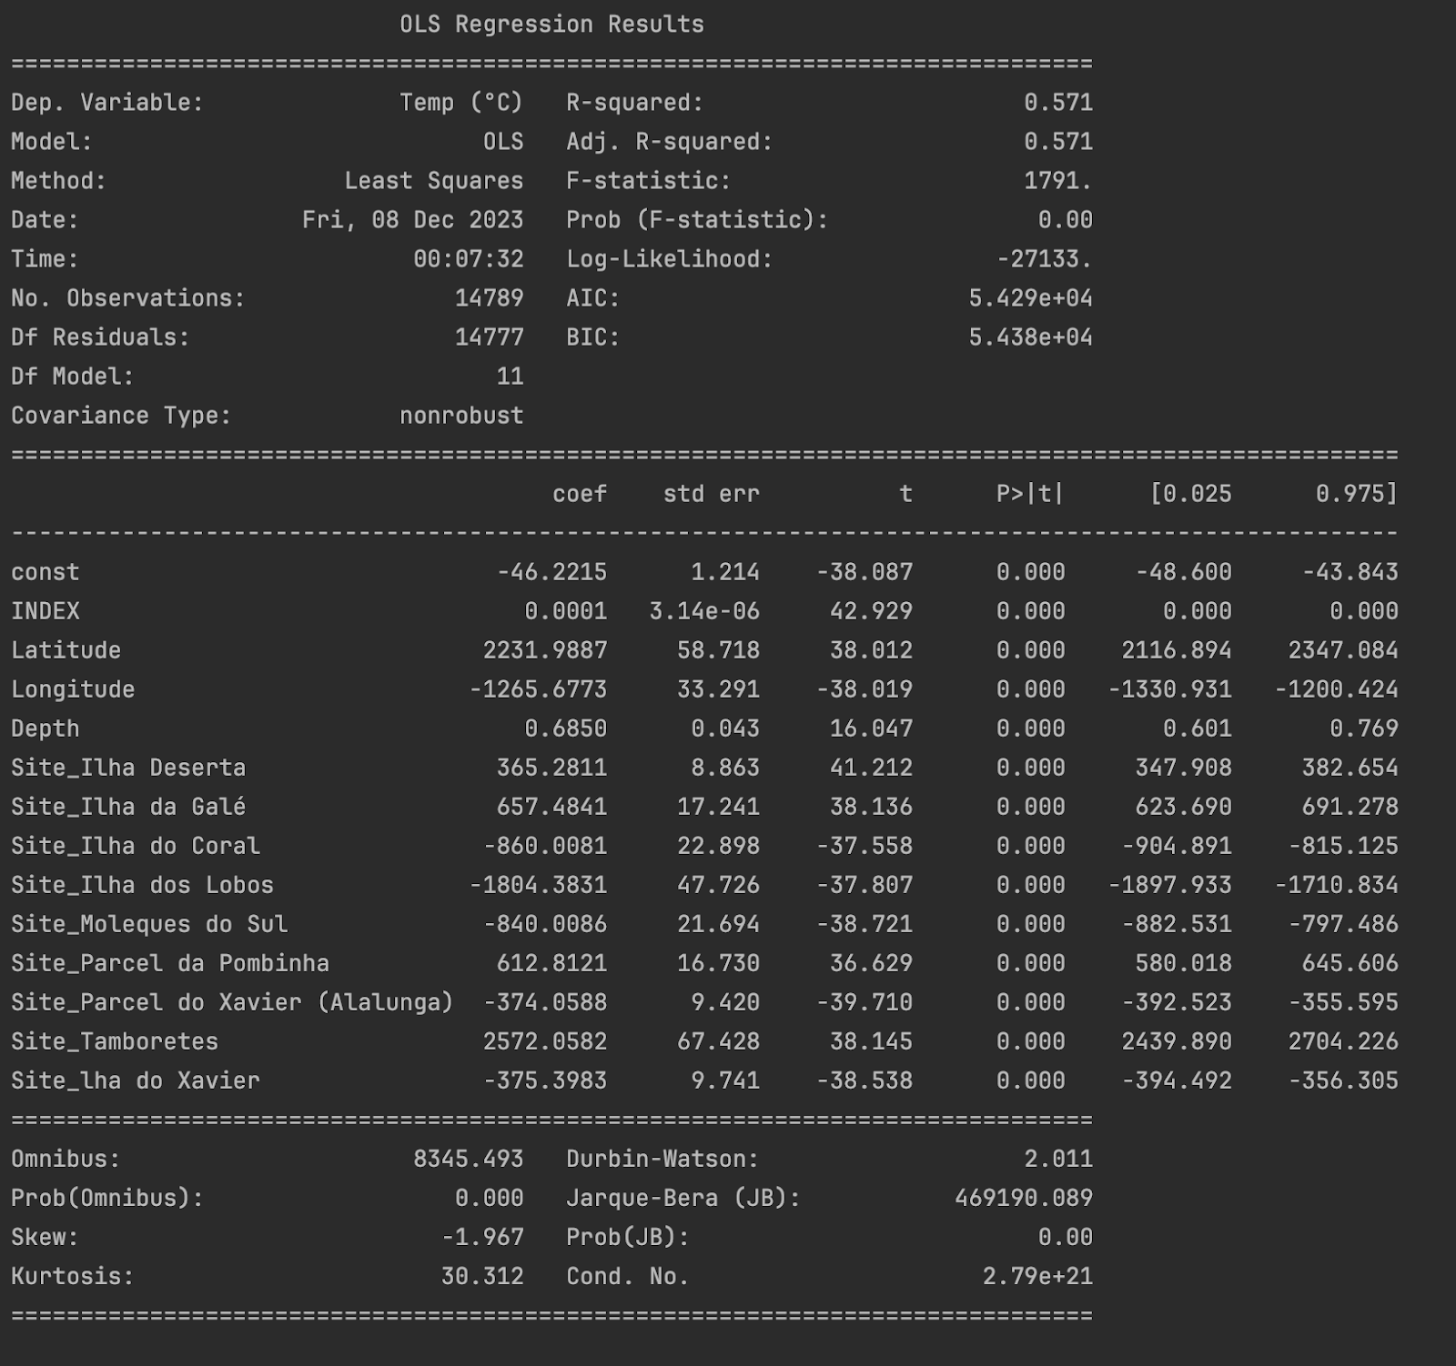
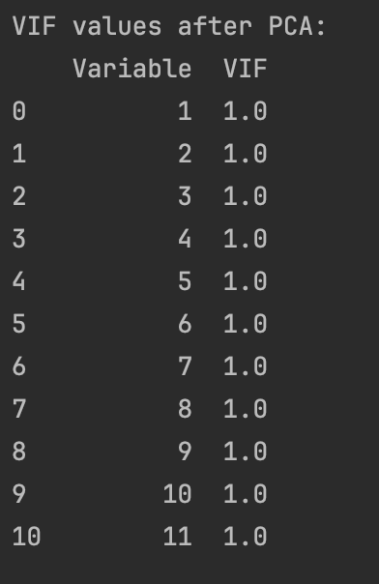
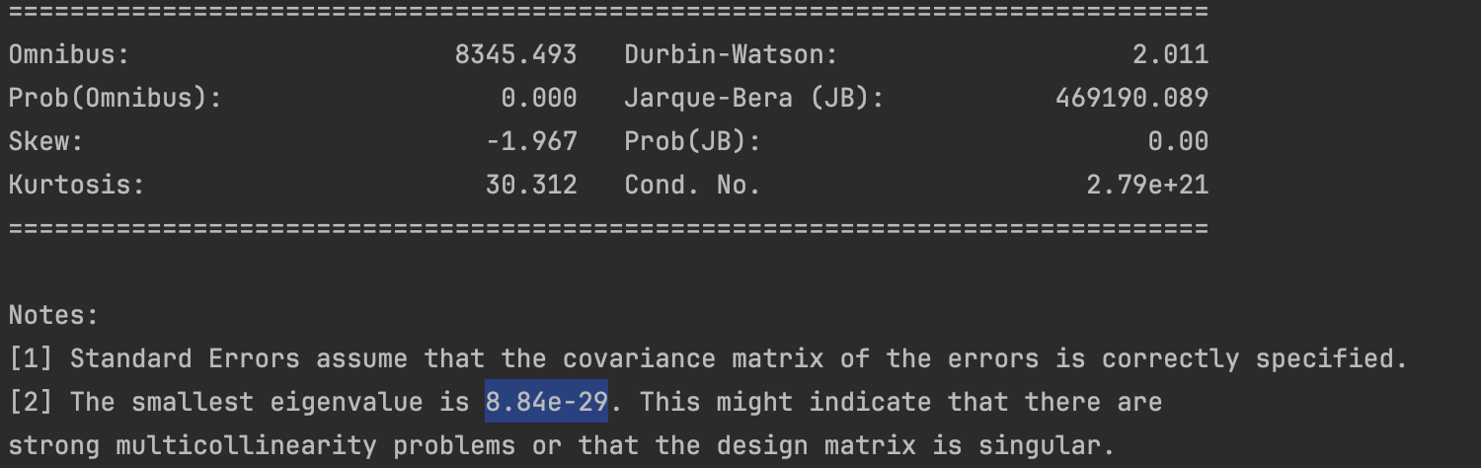
FEATURE SELECTION:
The P-value suggests that the model doesn’t have any collinearity issues whereas looking at the eigen value, the eigen value is too small.
the ridge regression, VIF anad pca were used In order to reduce the hidden collinearity.
After PCA, the collinearity became 1 and the model had 0 collinearity.

Slide 14
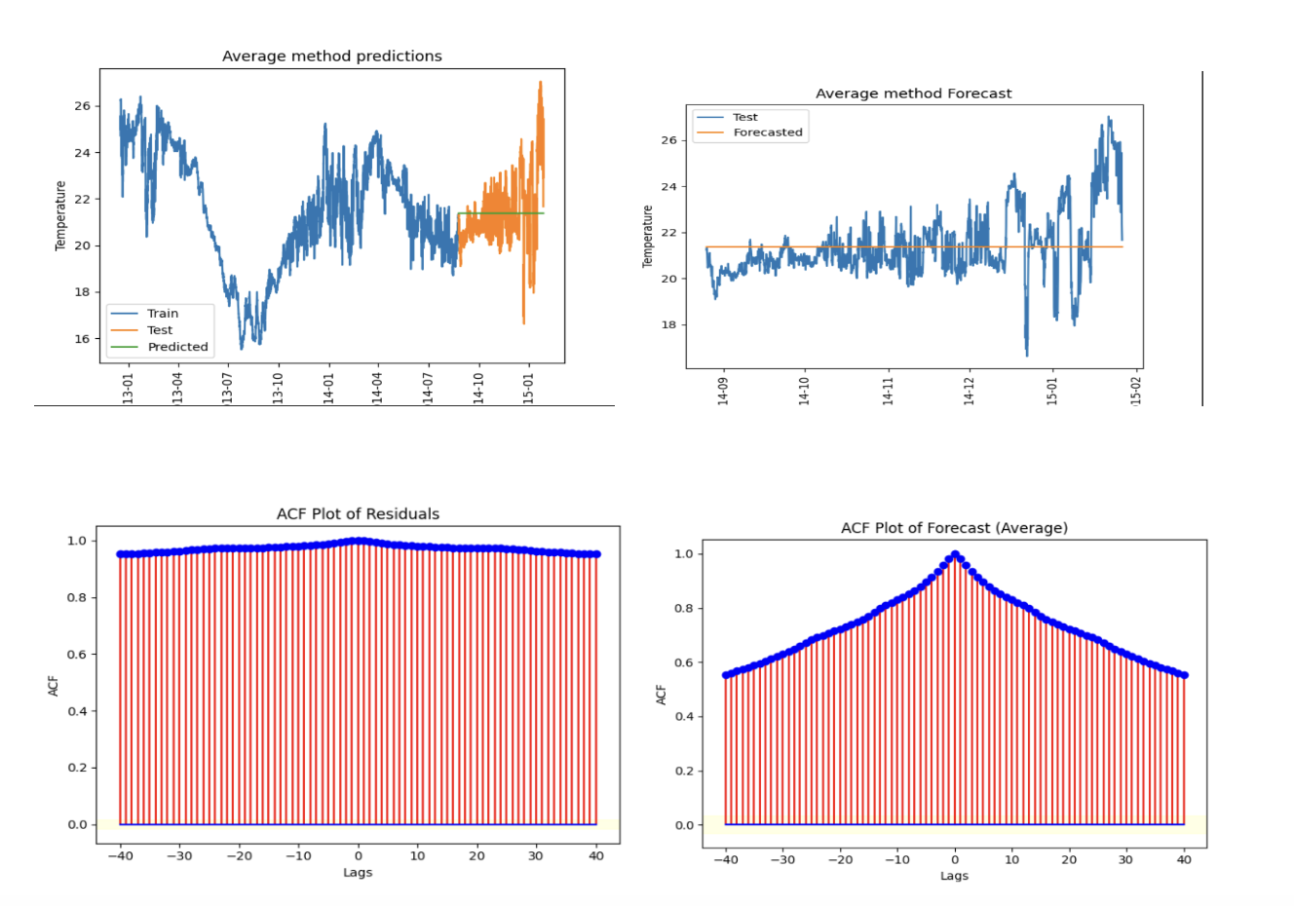
BASE MODELS:
AVERAGE METHOD:

Slide 15
PERFORMANCE METRICS OF
AVERAGE METHOD
METRICS | VALUES
MSE TRAIN | 6.105
RMSE TRAIN | 2.470
Q-VALUE | 3572.03
MEAN OF RESIDUAL | -0.9792
MEAN OF FORECASTED | 0.0187
VARIANCE OF RESIDUAL | 5.1466
VARIANCE OF FORECASTED | 2.2381
MSE TEST | 2.2385
RMSE TEST | 1.496

Slide 16
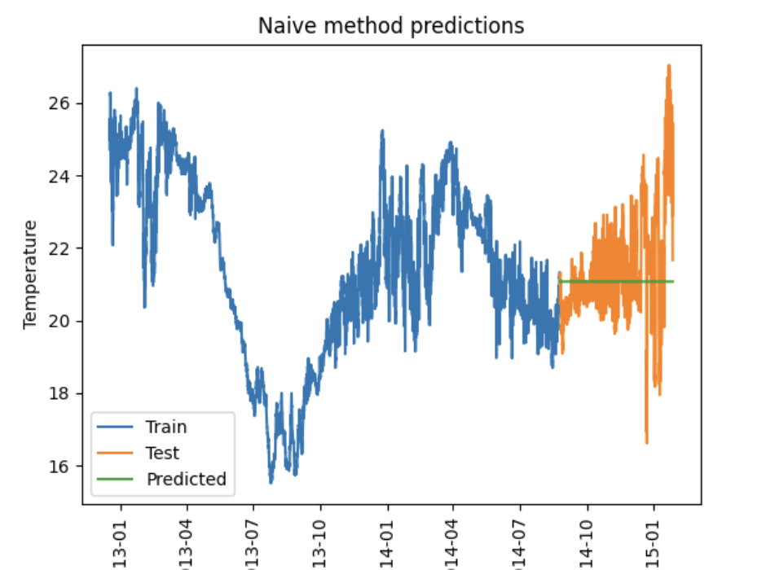
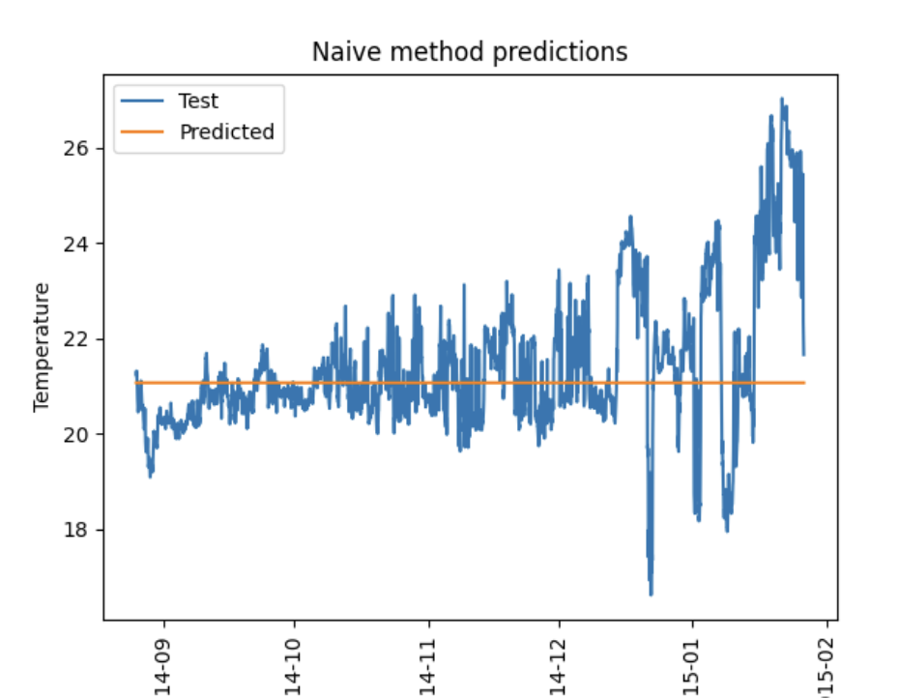
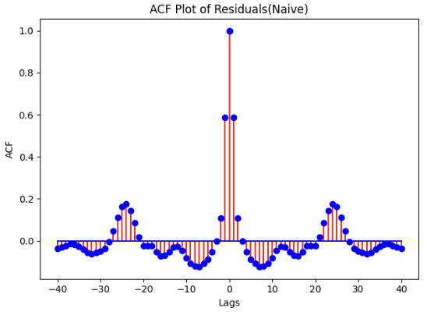
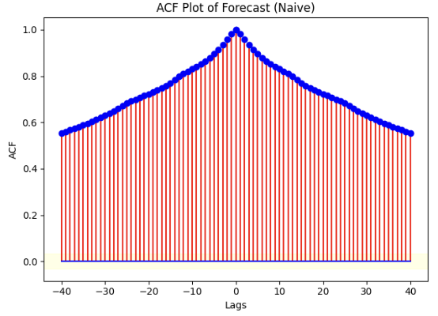
NAÏVE METHOD:

Slide 17
PERFORMANCE METRICS OF
NAIVE METHOD
METRICS | VALUES
MSE TRAIN | 0.0440
RMSE TRAIN | 0.209
Q-VALUE | 3572.98
MEAN OF RESIDUAL | -0.00029
MEAN OF FORECASTED | 0 (21.073)
VARIANCE OF RESIDUAL | 0.0440
VARIANCE OF FORECASTED | 0 (5.05e-29)
MSE TEST | 2.341
RMSE TEST | 1.530

Slide 18
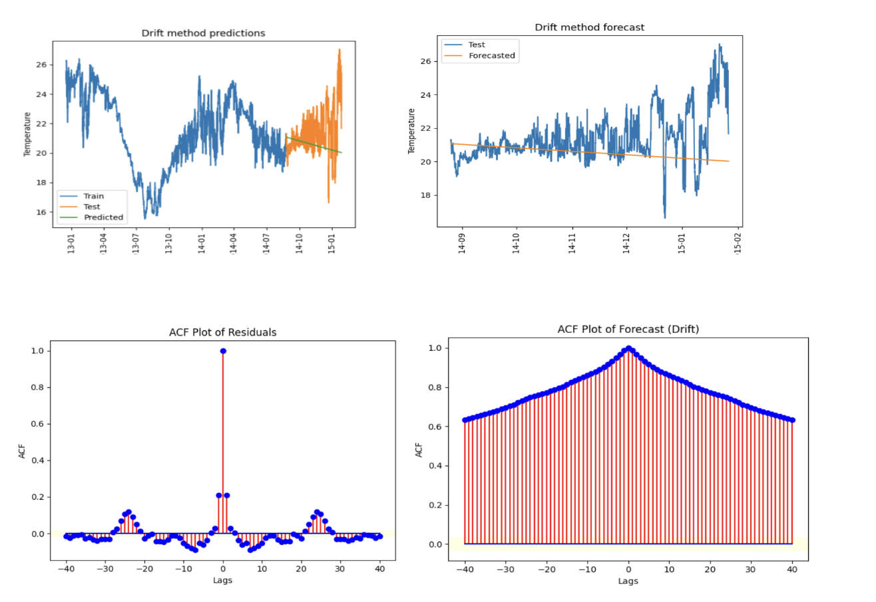
DRIFT METHOD:

Slide 19
PERFORMANCE METRICS OF
DRIFT METHOD
METRICS | VALUES
MSE TRAIN | 0.01780
RMSE TRAIN | 0.1333
Q-VALUE | 3596.99
MEAN OF RESIDUAL | 0.00050
MEAN OF FORECASTED | 0.846
VARIANCE OF RESIDUAL | 0.0178
VARIANCE OF FORECASTED | 2.781
MSE TEST | 3.497
RMSE TEST | 1.870

Slide 20
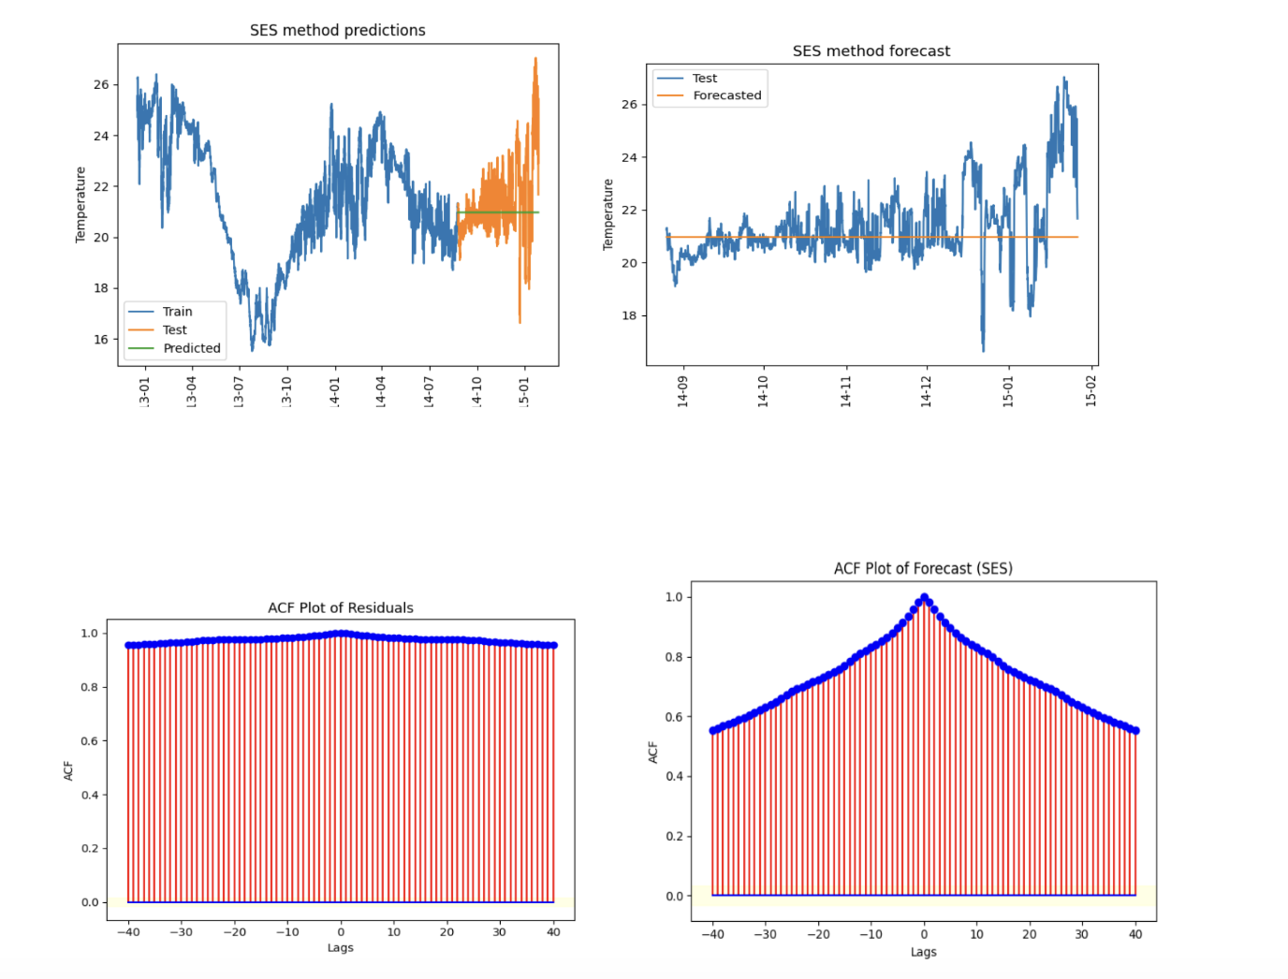
SES METHOD:

Slide 21
PERFORMANCE METRICS OF
SES METHOD
METRICS | VALUES
MSE TRAIN | 6.2699
RMSE TRAIN | 2.5039
Q-VALUE | 3572.98
MEAN OF RESIDUAL | 0.4071
MEAN OF FORECASTED | 0.4264
VARIANCE OF RESIDUAL | 6.1027
VARIANCE OF FORECASTED | 2.2381
MSE TEST | 2.4199
RMSE TEST | 1.5556

Slide 22
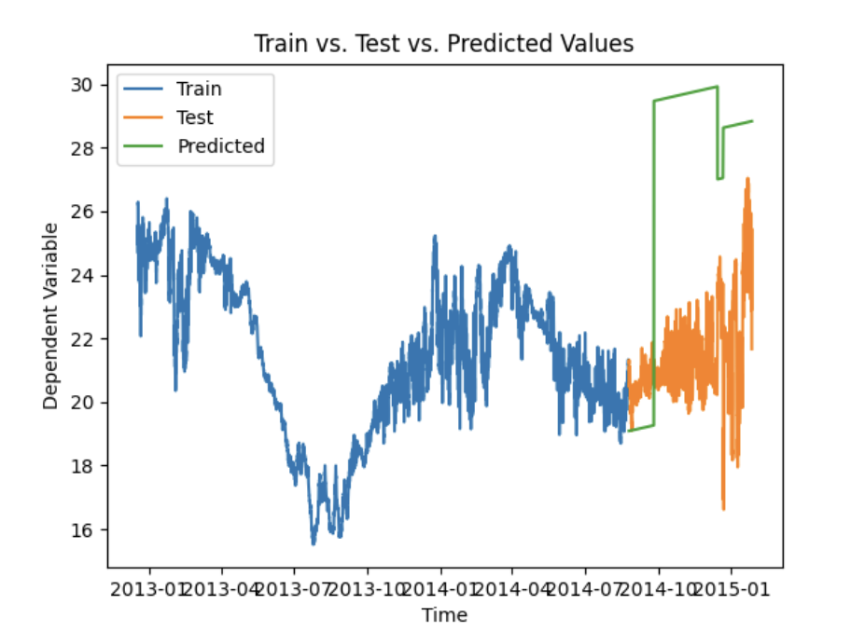
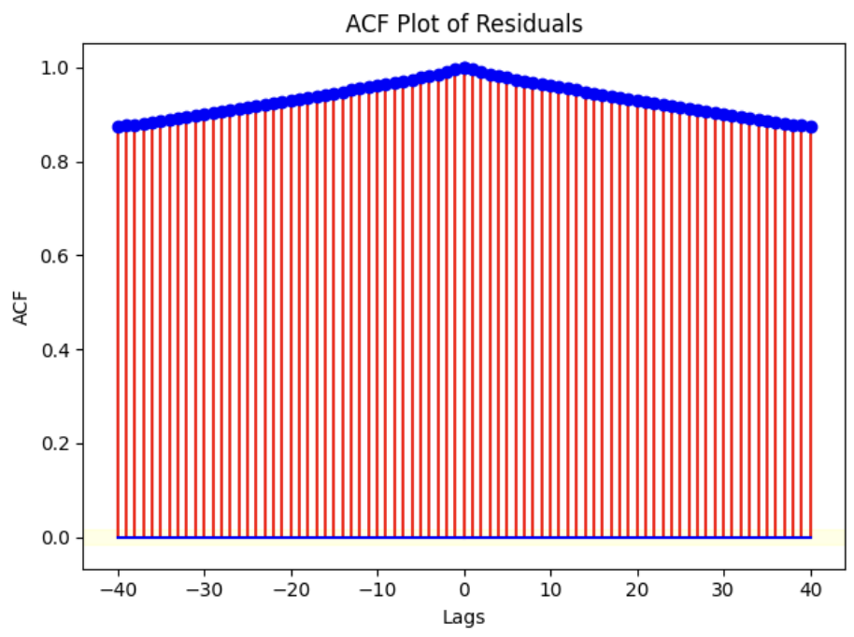
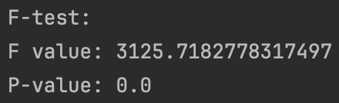
MULTIPLE LINEAR REGRESSION
The Plot of MLR of train vs test and predicted values doesn’t make sense because the predicted plot didn’t go well.
ACF plot shows that the residuals doesn’t have any white noise.
The F-TEST shows that the p-value Is 0.0 and f-value is 3125.71.

Slide 23
PERFORMANCE METRICS OF
MLR MODEL
METRICS | VALUES
MSE TRAIN | 1.8347
RMSE TRAIN | 1.3545
Q-VALUE | 3671.90
MEAN OF RESIDUAL | -5.8280
MEAN OF FORECASTED | -3.263
VARIANCE OF RESIDUAL | 16.4792
VARIANCE OF FORECASTED | 1.8347
MSE TEST | 50.4449
RMSE TEST | 7.102

Slide 24
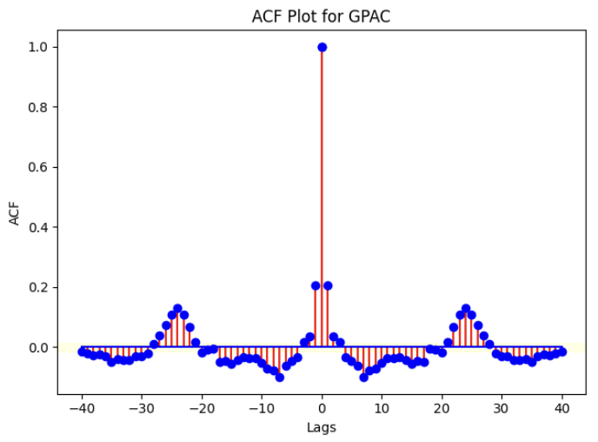
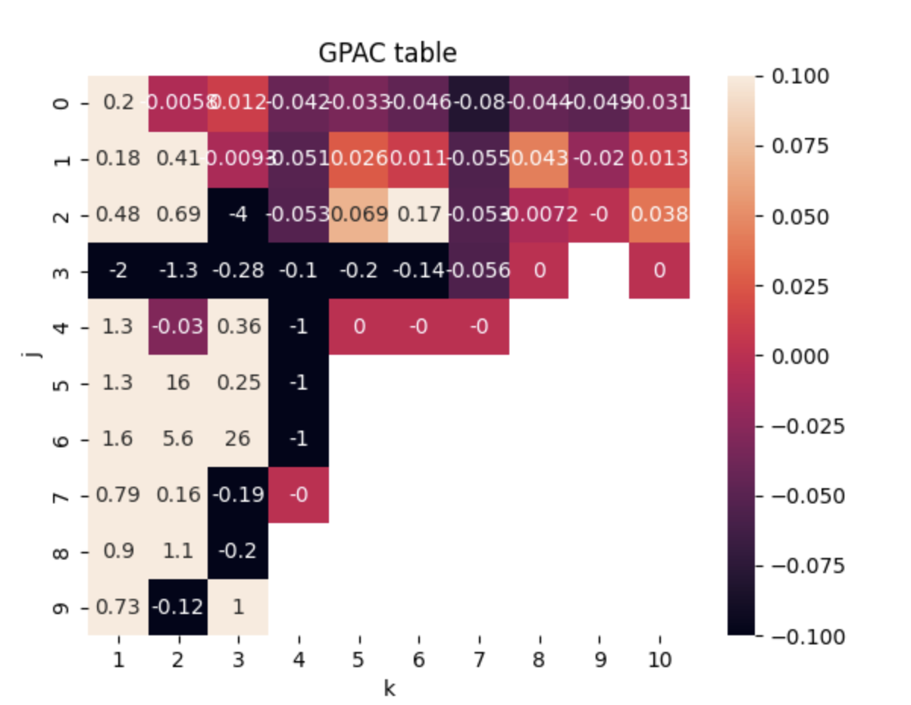
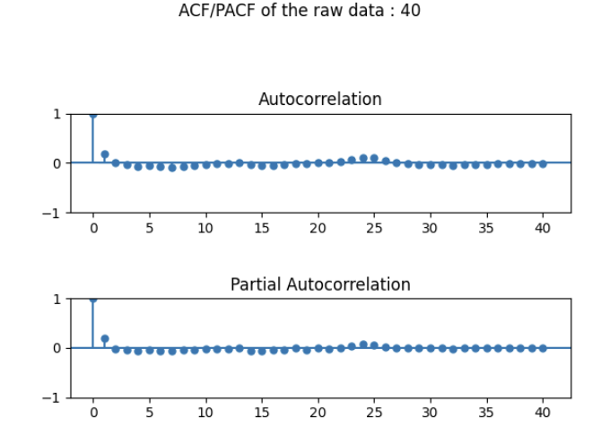
ARMA, ARIMA AND SARIMA MODELS:
Looking at the plots of ACF/PACF generated for GPAC, we can see that both the values converge over the lags.
The GPAC shows an order of na = 1, nb = 0 which is (1,0).
The acf plot is white and it converges over the time.

Slide 25
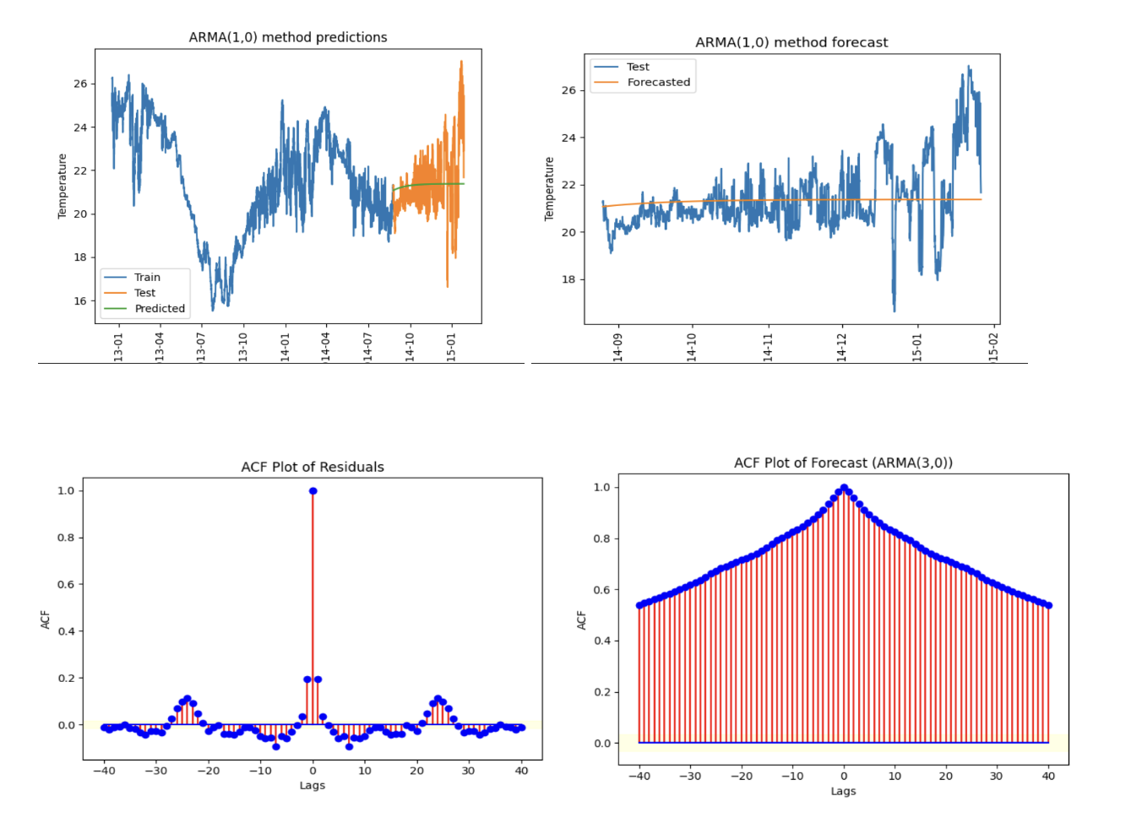
Looking at the ACF plot of residuals of the ARMA(1,0) process, the ACF values are white which can be considered as a better model for forecast. But the ACF values after forecasting on test data doesn’t look like white. So, it shows the model won’t perform well on test data.
The plot of train versus predicted data shows the model hasn’t captured the data of test data well but looking at the train values, the model didn’t perform well due to the bias in the estimators.
The AR co-efficient and estimated parameter is shown below.

Slide 26
PERFORMANCE METRICS OF
ARMA (1,0) MODEL
METRICS | VALUES
MSE TRAIN | 0.018788
RMSE TRAIN | 0.13707
Q-VALUE | 3568.86
MEAN OF RESIDUAL | -2.04188
MEAN OF FORECASTED | 0.0716
VARIANCE OF RESIDUAL | 0.018788
VARIANCE OF FORECASTED | 2.1657
MSE TEST | 2.170861
RMSE TEST | 1.47338

Slide 27
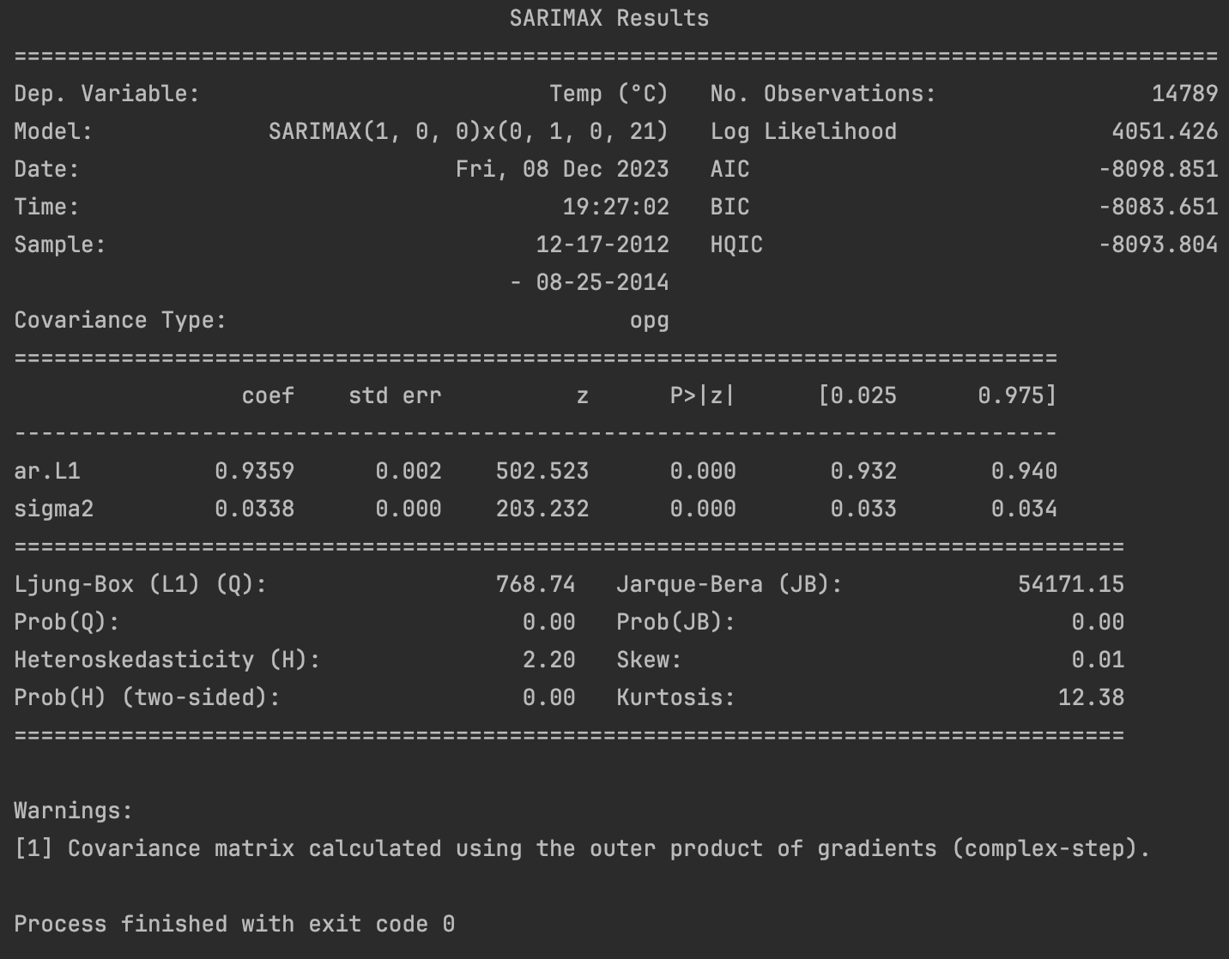
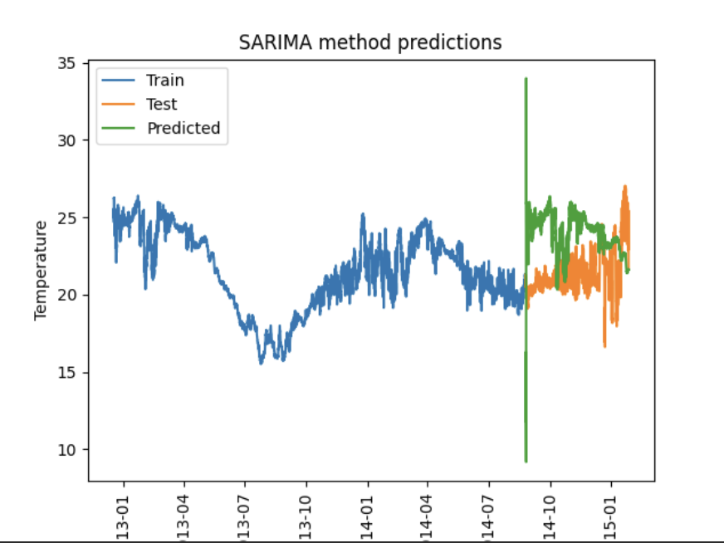
SARIMA Model:

Slide 28
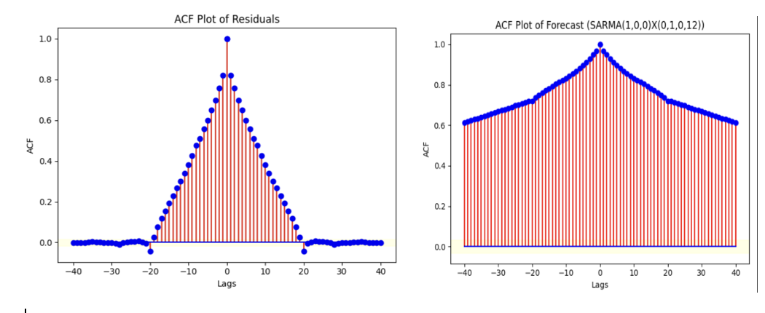
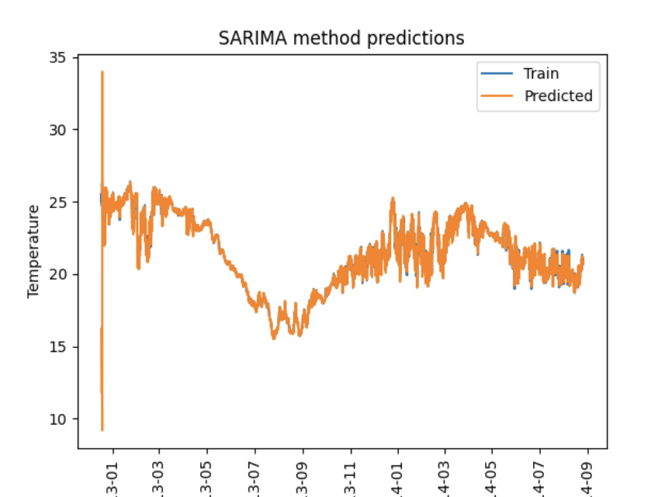
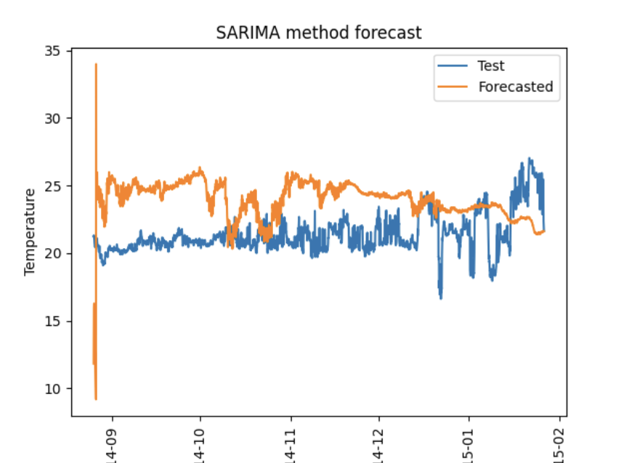

Slide 29
PERFORMANCE METRICS OF
SAMRIMA(1,0,0)*(0,1,0,21) MODEL
METRICS | VALUES
MSE TRAIN | 0.243467
RMSE TRAIN | 0.493424
Q-VALUE | 3466.00
MEAN OF RESIDUAL | 0.016184
MEAN OF FORECASTED | -2.552816
VARIANCE OF RESIDUAL | 0.24320
VARIANCE OF FORECASTED | 5.3842
MSE TEST | 11.9011
RMSE TEST | 3.44980

Slide 30
FINAL MODEL SELECTION
METRICS | HOLTS WINTER | AVG. | NAÏVE | DRIFT | SES | MLR | ARMA (1,0) | SARIMA
MSE TRAIN | 0.016093 | 6.10558 | 0.04404 | 0.017855 | 6.269933 | 1.83473 | 0.018788 | 0.243467
Q-VALUE | 3573.402682 | 3572.0305 | 3572.98 | 3596.88 | 3572.98 | 3671.90 | 3568.86 | 3466.00
MEAN RESID | -0.00018 | -0.979270 | -0.000293 | 0.000507399 | 0.407120 | -5.82800 | -2.04188 | 0.016184
VAR. RESID | 0.016093 | 5.14661 | 0.044040 | 0.017855 | 6.102703 | 16.4792 | 0.018788 | 0.243205
RMSE TRAIN | 0.12686 | 2.47094 | 0.209858 | 0.13362 | 2.50398 | 1.35452 | 0.13707 | 0.493424
MSE TEST | 2.35319 | 2.2385 | 2.34133 | 3.49735 | 2.41998 | 50.4449 | 2.170861 | 11.90115
RMSE TEST | 1.53401 | 1.4961 | 1.53014 | 1.87012 | 1.555628 | 7.102458 | 1.47338 | 3.449804

Slide 31
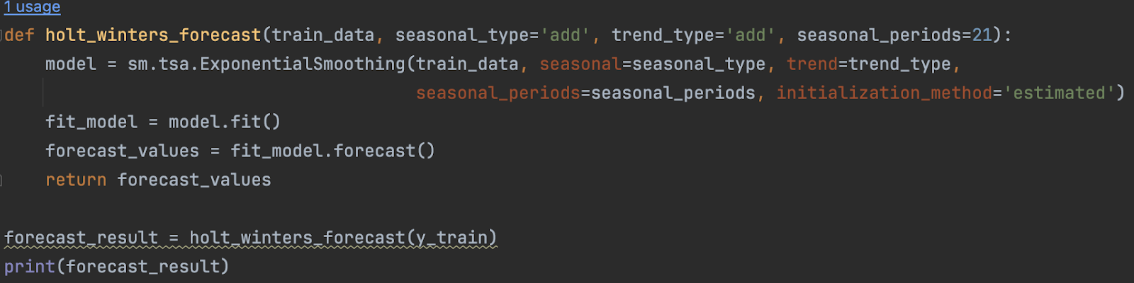
FORECAST FUNCTIONS:

Slide 32
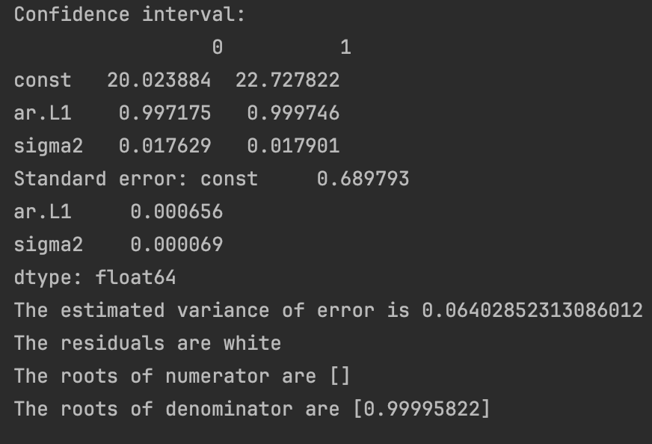
RESIDUAL ANALYSIS AND DIAGNOSTIC TEST
The confidence interval is perfectly stating the range of ar.l1 value
Covariance matrix shows the values of the ar.
The variance error is 0.065(rounding off)
The chi squared test shows that the residuals are white
The zero pole cancellation didn’t happen because there is no value for the numerator.

Slide 33


H-STEP AHEAD PREDICTIONS
I did the h-step prediction for the whole test set and the output is shown.
The plot shows the test set and h_step predicted values and it is shown that the forecasted values of h-step captured the test set well and the model is best suited.

Slide 34
CONCLUSION:
The Holt winter model has been determined to be the most accurate model for predicting the temperature at the underwater surface.
The model's performance on the test and train sets of data was taken into account during selection.
Taking into account that other models in the competition that used this model, ARMA, had lower MSE on train data, but the model didn't capture the precise data on the test data, as evidenced by the model's simple line appearance in the plot of the predicted vs. test set.
Although the computational complexity of 21 seasonality hampered the SARIMA, it still performed well on both train and test data; nonetheless, the Holt Winter model outperformed it when compared to the MSE on test data.

Slide 35
FUTURE SCOPE
SARIMA model with seasonality of 1260 can be utilized on powerful computing platforms to get beyond this restriction and predict dataset results that are more accurate.
The implementation of a SARIMA model with precise seasonal order or LSTM, a neural network-based model with a globally viewable user interactive dash app that can be developed in order to identify the underwater surface temperature, would be the project's future enhancement.

Slide 36
REFERENCES:
https://www.seanoe.org/data/00510/62120/
https://www.kaggle.com/code/ashutoshp2002/underwater-temperature-prediction
https://towardsdatascience.com/time-series-forecasting-with-arima-sarima-and-sarimax-ee61099e78f6
https://github.com/imkhoa99/Time-Series-Analysis-and-Weather-Forecast-/blob/master/Time_Series_Project.ipynb
Class lectures, lecture videos
Class homeworks, Labs

